Slide 1

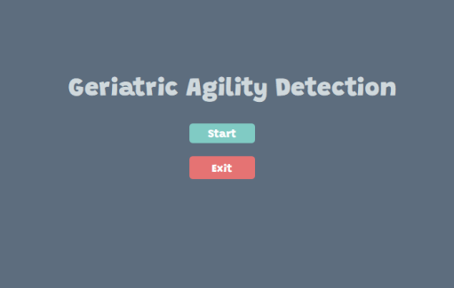
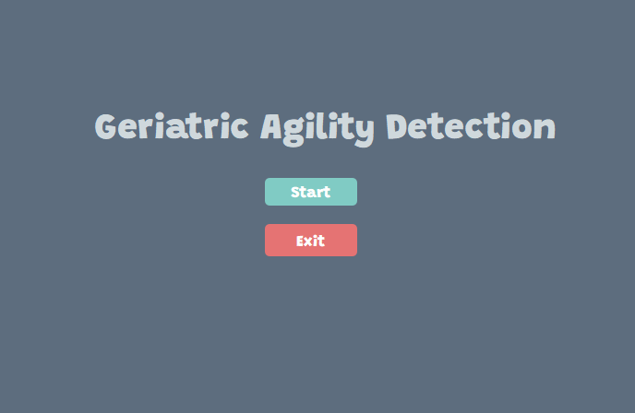
Geriatric Agility Detection
Minor Project 2020

Slide 2

Meet The Team
Nikhil Chandna
Sudeep Srivastava
Suryansh Singh
Supervised by Dr Suma Dawn

Slide 3

Outline
Motivation Behind The Project
Project Type
Problem Statement
Solution Proposed
Languages and Modules Used
Data Flow Diagrams
Screenshots
Timeline
Appendix and References

Slide 4



Languages and Modules
-Python -Libraries: -OpenCV -PyQt5 Threading

Slide 5
Motivation Behind The Project
Regular exercise provides a myriad of health benefits in older adults, including improvements in blood pressure, diabetes, lipid profile, osteoarthritis and neurocognitive function. Regular physical activity is also associated with decreased mortality and age-related morbidity in older adults.

Slide 6
Motivation Behind The Project
However, up to 75 percent of elderly are insufficiently active to achieve these health benefits.
That is why we wanted to create an easy-to-use screening tools to guide adults through the process of initiating an exercise program with no input or supervision from an exercise or health/ fitness professional.
There exists a series of tests that are designed to test the fitness of seniors. The chair stand test is one of these tests and we intend to use it to gauge the fitness level of the people.

Slide 7

Project Type:
Pure development project

Slide 8
Problem statement
We came across a few ways of how to perform a chair stand test like with the help of a trainer or by using sensitive plates and other hardware. Therefore, we wanted something more simple and easy to use to help solve the problem. Hence, we picked this project to solve the issue with our own idea.

Slide 9

Solution Proposal
Solution Description
Why it is better than existing solution

Slide 10
Solution description
The program would be able to count the number of times a person does complete chair stands as part of the chair stand test with the help of just a camera.
It will then tell the user how they performed based on their age and gender.

Slide 11
Solution description
The program will make a virtual box above the user’s head and first register the background. Then it’ll constantly check for any kind of color change inside the box. So when the user enters/leaves the box to stand/sit, the program will be able to count the number of complete chair stands.

Slide 12
Why it’s better than existing solutions
There are no hardware requirements like sensor belts, force plates, or depth sensor cameras. While these do get the job done, they seem excessive for a simple task such as counting.
Our solution also works very well in low lighting conditions.

Slide 13
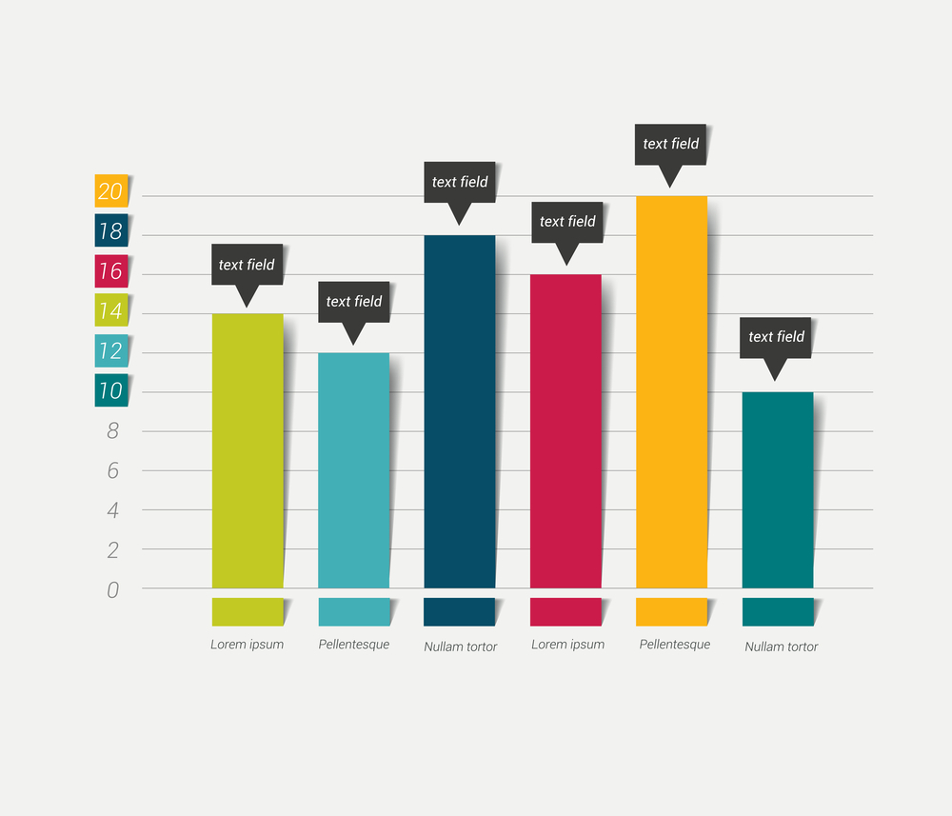
Data Flow Diagram
Level 0
Level 1

Slide 14
Data Flow Diagram
LEVEL 0
1) Age
2)Gender
3)User live Video
INPUT
1) Your Test Count
2) Your Performance
OUTPUT
Component Detail (Mobile)

Slide 15
LEVEL -1
D
A
T
A
F
L
O
W
D
I
A
G
R
A
M
GUI
APPEARS
Press
“start”
Enter Your Age and Gender
New Window Appear
Press “ok”
Video Capture Start
(Background Registration Stage)
Press
“cancel”
Press
“exit”
Press “Enter”
PROGRAM
ENDS
Timer Started
Background Register
Complete
(Popup window appear having
Registered background color)
After 30 second
Chair Stand Test started
Press
“Enter”
Display Of
Result
Recording Started

Slide 16
Screenshots Of a Program:
Start The Program

Slide 17
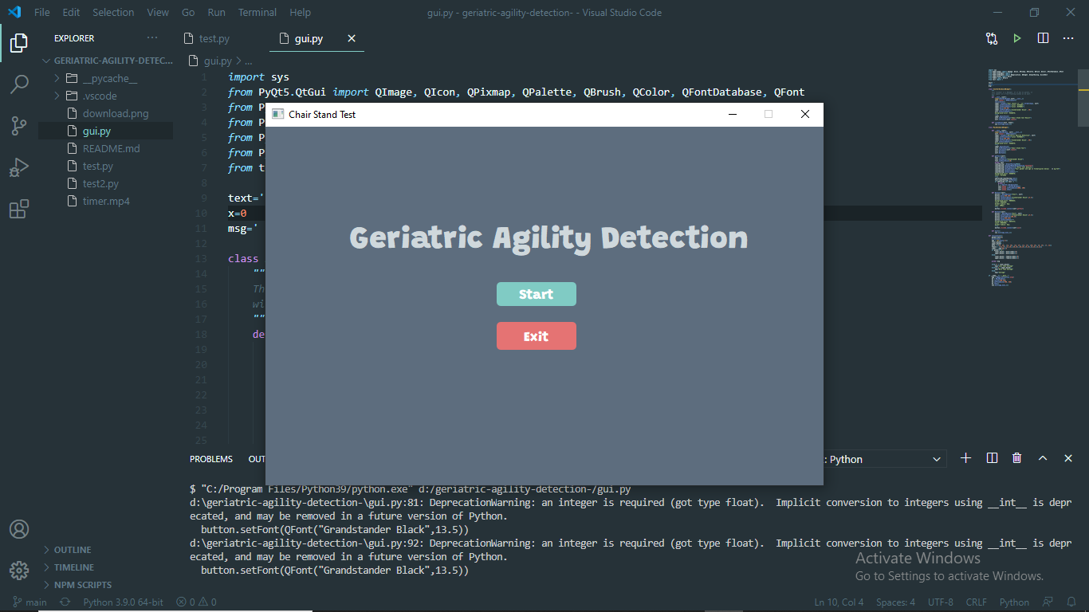
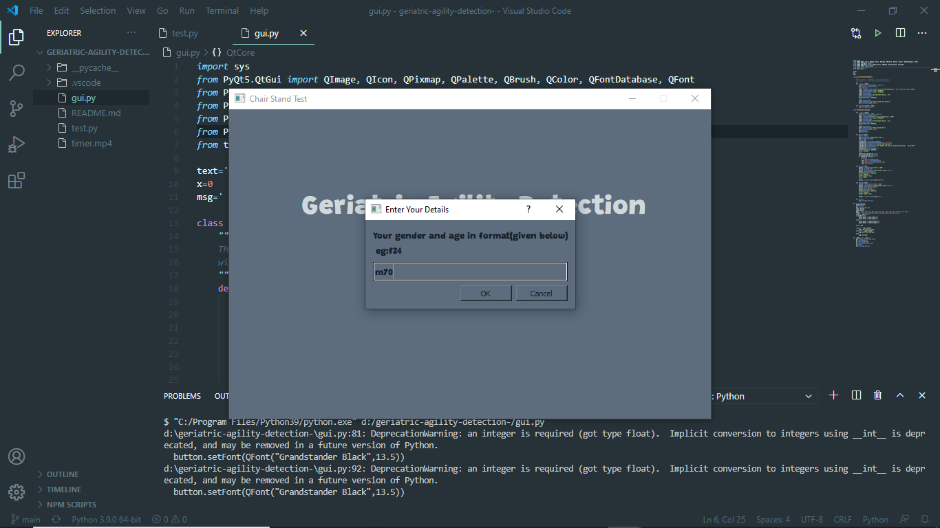

Slide 18
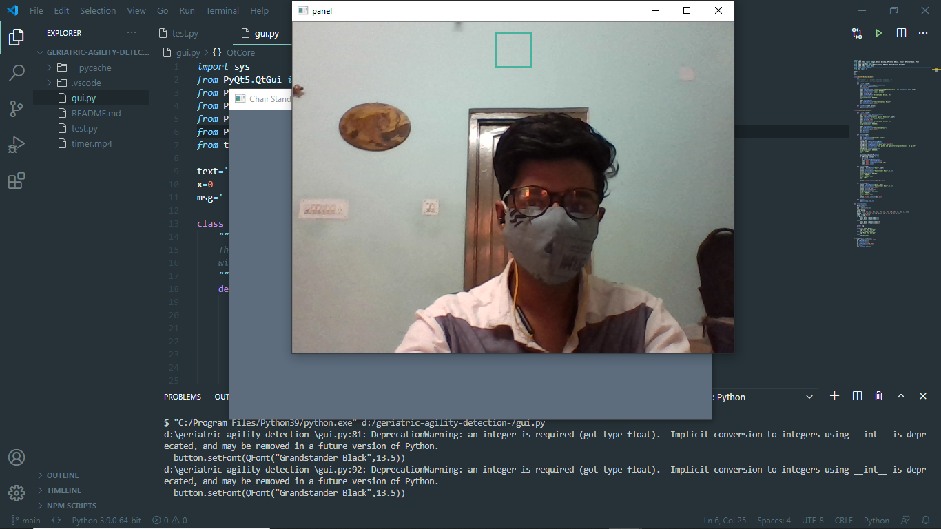
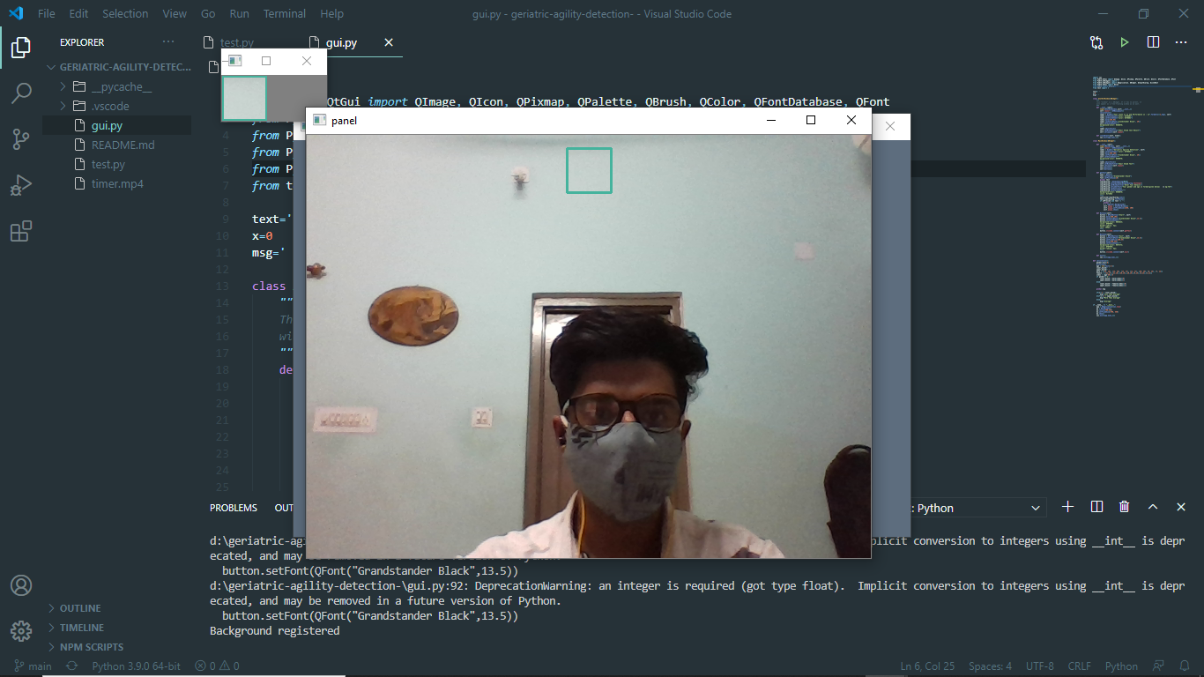

Slide 19
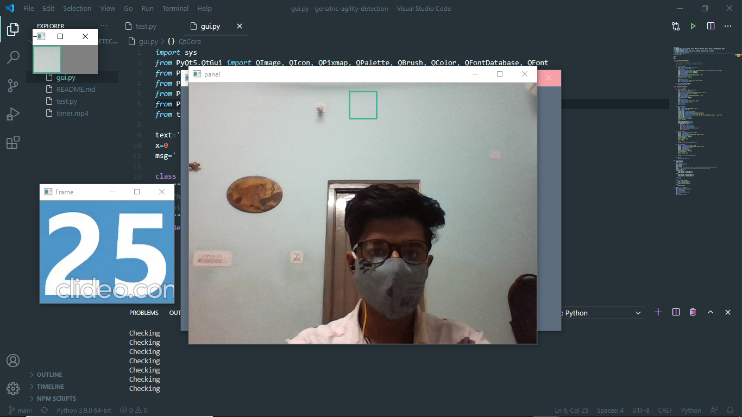
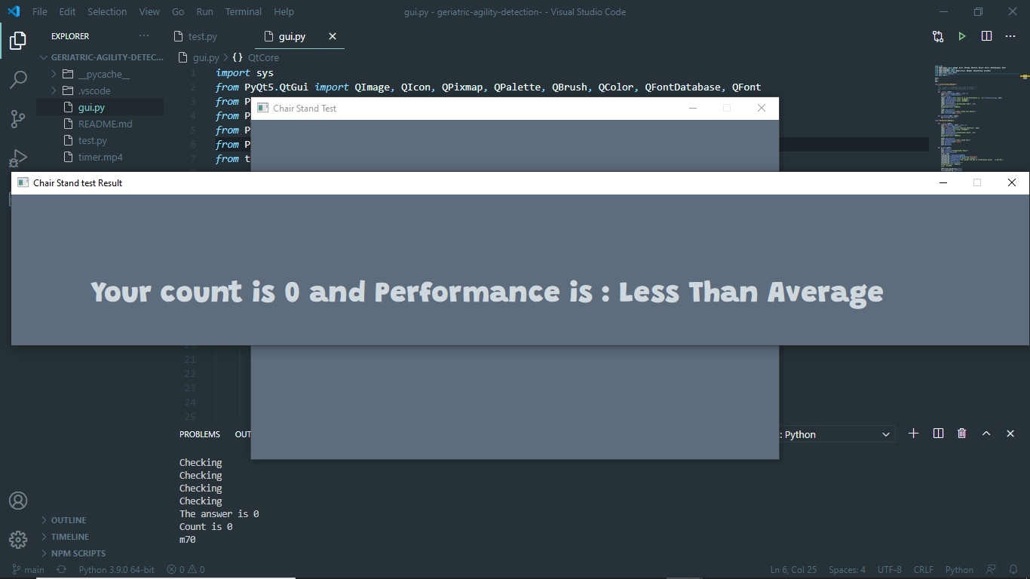

Slide 20
Timeline
Nov
Nov
28
17
First Commit
Connecting GUI
Nov
Dec
2
Added Multi-Threading
18
Added Color Detection and Webcam Code
Nov
Dec
3
21
Added and Positioned Visual Box
Added Camera Bug
Nov
Dec
Added Initial GUI
Added Second Window
3
24
Dec
4
Code Cleaning 2.0 (Final Product)

Slide 21


Appendix
Github code repository
References
The 30-Second Chair Stand Test
Measurement of the Chair Rise Performance of Older People Based on Force Plates
and IMUs

